Slide 1




VSTS, ARM, DSC and SharePoint 2019 A match made in heaven
Nik Charlebois
Senior Premier Field Engineer | Microsoft

Slide 2


@NikCharlebois
Microsoft Senior Premier Field Engineer
Focusing on SharePoint Development and Automation
Overall DSC goodness evangelist
About Me
Ex-PowerShell MVP
Author of the books Beginning PowerShell for SharePoint 2013 and 2016 & Office 365 Experts
Based in Gatineau, Quebec
Blogger at https://NikCharlebois.com
Co-owner of SharePointDSC and owner & creator of ReverseDSC

Slide 3

Download the SPTechCon Mobile App!
Search for SPTechCon in your App Store and download the 2018 Mobile App to stay connected throughout the entire event.
• Conference and Session Feedback • Get up-to-date show details
• Reference speaker profiles
• Take notes and download presentations
• Connect with other attendees
• Find exhibiting sponsors and much more!

Slide 4

Setting the Expectations
Focus is on 2019 On-Prem deployed to Azure (but applicable to 2013 & 2016);
Some prior knowledge of DSC and ARM will be useful;
Session focuses on building a complete Proof-of-Concept;

Slide 5


Slide 6

Proof-of-Concept - Goals
Manage Configuration as code in Visual Studio Team Services;
Continuous Integration and Deployment of Configuration changes;
Delete entire environment and start over in a repeatable fashion;

Slide 7



Proof-of-Concept - Components
SharePoint 2019 Dev Farm
Azure
ARM Templates
Visual Studio Team Services
VSTS Online
Git Source Control*
Azure Automation
Azure
DSC Scripts
* Would work just fine with a TFS repo

Slide 8


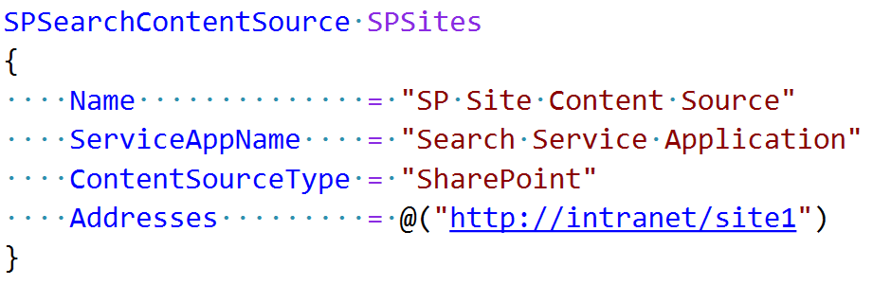
Proof-of-Concept – Typical Scenario
IT Admin opens Visual Studio Code, adds a DSC block to define the new content source.
IT Admin
VSTS
Upon successful build, VSTS pushes the DSC script to Azure Automation using an Azure PowerShell task within the Release Definition.
Azure Automation DSC pushes the changes to the Dev environment.
IT Admin commits the change back to VSTS.
VSTS Initiates a new Dev Build.
IT Admin wants to add a new Search Content Source to the Environment.
Azure Automation
SharePoint Dev Farm

Slide 9

Azure Resource Manager

Slide 10


Overview of Azure Resource Manager (ARM)
.JSON file that defines the components of our VMs;
Used to automate the deployment of our SharePoint Farm VMs in Azure;
Can obtain .JSON file from the VM creation wizard in the Azure Portal;

Slide 11


ARM Templates
Editor available in VS Code;
Azure exposes an endpoint to allow One-Click Deployments;
Ability to use ARMViz to visualize the components of the template;

Slide 12

Scenario – Dev Environment
SharePoint 2019
(Web Front-End)
Domain Controller
(contoso.com)
SQL 2017
SharePoint 2019
(Application)
SharePoint 2019
(Search)

Slide 13

ARM Template Overview

Slide 14
Desired State Configuration

Slide 15

What is PowerShell DSC (10,000 Feet View)
Automate configuration and monitoring of environments;
Make sure environments stay in their “desired” configurations (no configuration drifts);
PowerShell 4.0 and above (SP2010 not supported);

Slide 16
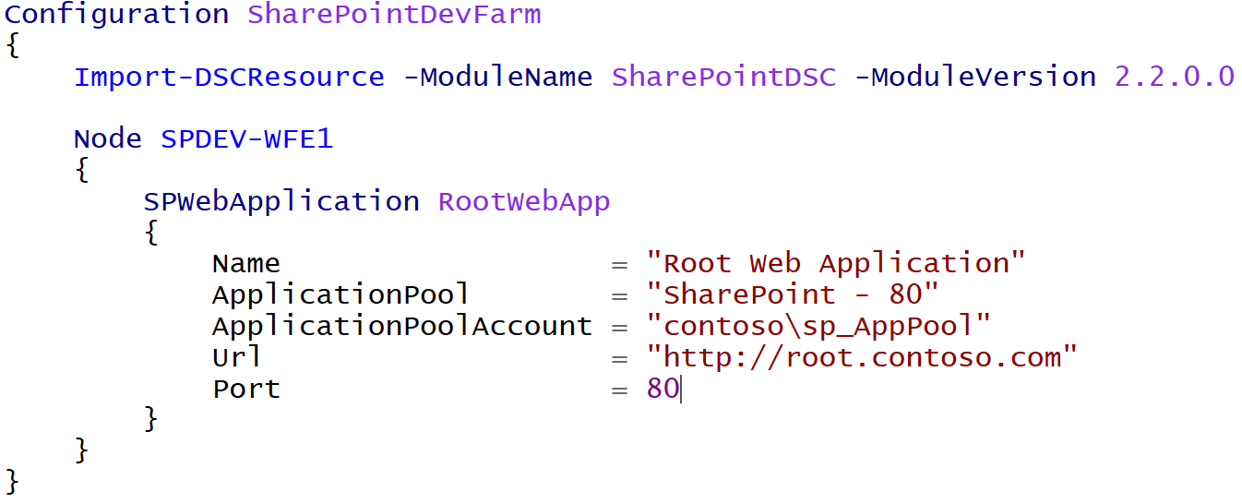
How Does it Differ from “Classic” PowerShell?
It is a Declarative approach;
Notes:
Meaning I don’t tell it do this and then that, but rather here is how I want this, then do whatever in you need to to get me there

Slide 17
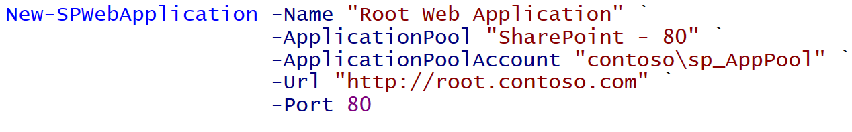
Imperative
Declarative
Notes:
Same result. Yes more lines in this example, but ensures it stays in that state.

Slide 18

Prevent Configuration Drifts
ApplyOnly
ApplyAndMonitor
ApplyAndAutoCorrect
These are known as DSC Configuration Modes
Notes:
The default is apply and monitor, and honestly for SharePoint, you don’t want to go to ApplyAndAutocorrect;
Story of my customer and their spring cleaning of SPWebs

Slide 19
DSC Overview

Slide 20
Azure Automation

Slide 21

Overview of AADSC
Pull Server as a Service;
Included as part of an Azure Automation Account;
Offers both Process Automation (Runbooks, Jobs, etc.) & Configuration Management (DSC);

Slide 22


Overview of AADSC[…]
Azure Virtual Machine
DSC Script
Azure Automation

Slide 23
Azure Automation Overview

Slide 24

Demo 1 Search Content Source

Slide 25
Demo 2 Language Packs

Slide 26
Questions

